Slide 1
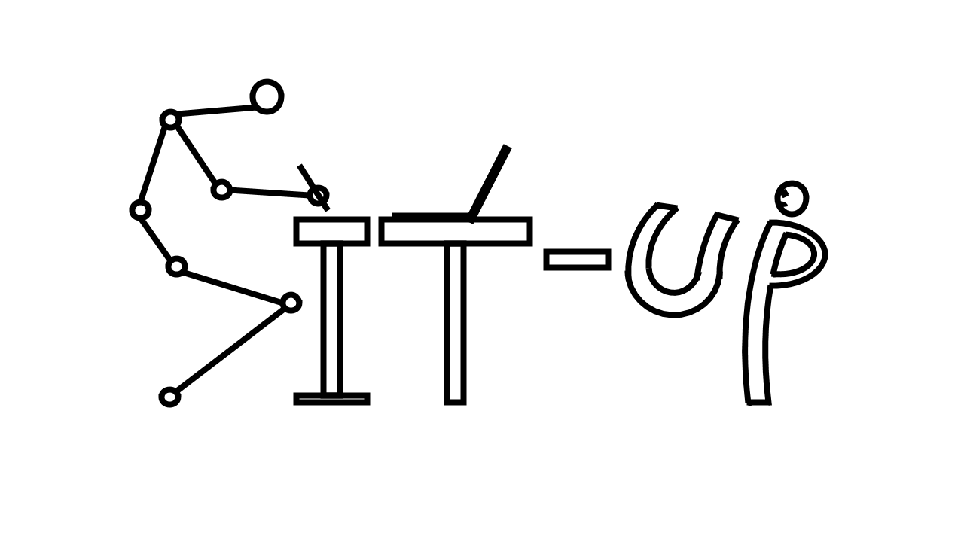
Sit-Up!
The personalized AI posture practitioner
Notes:
Since you are watching this presentation, you are probably sitting right now. But do you know sitting badly kills you?
Yeah, yeah, we all know we need to get exercise and we can’t just sit at our desk forever. But now, I am talking about the posture
Four months ago, I got an internship offer as a machine learning engineer, and that was one of my happiest moments in my life. However, that results in sitting in front of my office desk for almost my entire summer. Just like everyone else in the office, the sedentary lifestyle makes me feel the pain coming from my neck and back.

Slide 2
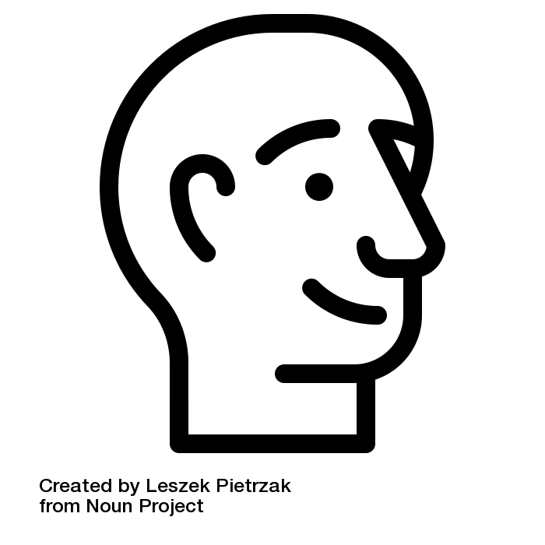
≈
10 pounds
[4.5 kg]
Notes:
The average human head weighs about 10 pounds [4.5 kg]. When you are slouching at your desk and hanging your head forward, you are putting that weight onto your upper spine.
Research shows that for every inch you hang your head forward, you are adding additional 10 pounds of pressure on your spine.

Slide 3

2 inch
≈
+ 9 L
Notes:
So, slouching forward 2 inches, is equivalent to hanging 9L of water onto your neck

Slide 4
PROBLEM INTRODUCTION
How bad posture can affect you ?
80%
of adults are suffering back pain caused by bad posture
Main Health Effects
Back, Neck, and Shoulder Pain
Poor Circulation
Increased Stress
Fatigue and Low productivity
86bil.
of low-back pain cost in US each year
$30,000
is spent on posture-related injuries per patient
33% of work injuries are posture-related
Notes:
Around 80% of adults are suffering back pain caused by bad posture. This astonishing number causes the US to spend at least $86 billion in health care on dealing with low-back pain.

Slide 5
CURRENT SOLUTIONS FOR POSTURE CORRECTION
The current products are still not effective to solve posture problems
Back brace
Muscle contraction detector
Ergonomics furniture
Notes:
In the current market, there are three main approaches that try to tackle this problem: back brace, muscle contraction detector, and ergonomics furniture.
Product like back brace or muscle detector only deal with one, or at most two, joints of your entire body. Not only they are inaccurate, but they are also uncomfortable.
You don’t want to put tape onto your skin in a daily bases, or spend thousands of dollars on this kind of chair, twice, for both your office and your own workspace.
Moreover, these devices establish a strong dependency, and never fix the problem from the root.
Is there really no way to help an average person to maintain a healthy posture?

Slide 6
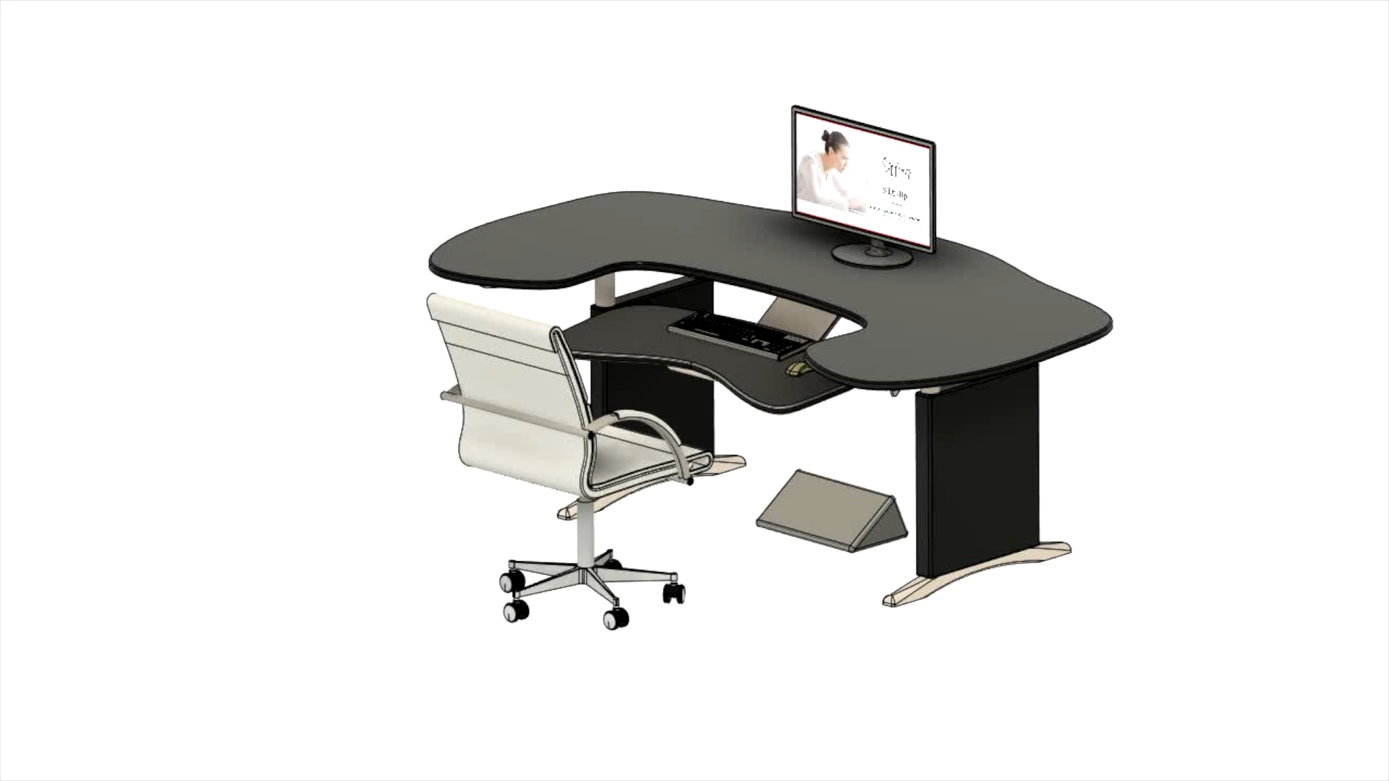
Sit-Up!
The personalized AI posture practitioner
Notes:
Now introducing Sit-up, the personalized AI posture practitioner for everyone.
Different from traditional approaches, Sit-up is a proactive solution that helps users to form healthy sitting posture without using any external, physical constraint.
This pocket-size, chargeable device is a product generated by mixing many cutting-edge technologies, such as deep learning, federated learning, computer vision, and model compression. Let me show you how it works:

Slide 7






THE PROCESS OF USE
Sit-Up! – How it works?
User
Long-term Feedback
Detection by computer vision
Posture Assessing Deep Learning Model
Collect data and Record stats.
Auto-generated Health Report
Instant Feedback
Notes:
Press the start button, let it sit beside you.
And that’s it! No needs to put it as a restricted angle, and no need for any other manual adjustment or calibration.
Give rest of the tasks to your personalized practitioner.
With computer vision, the camera will capture users’ body features, then passed to a deep learning AI model to locate your joints and determine your body posture.
Our backend will analyze the output posture, and provide sitting instruction based on the healthy posture standard given by medical research papers

Slide 8

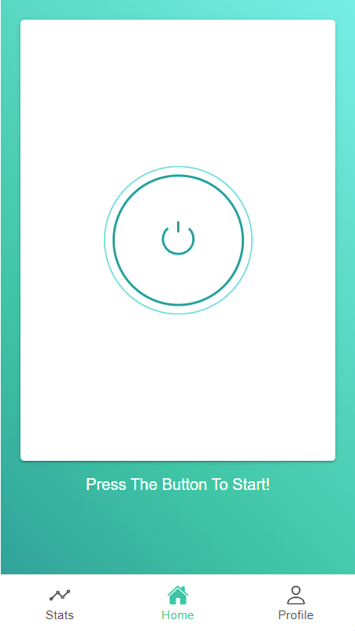
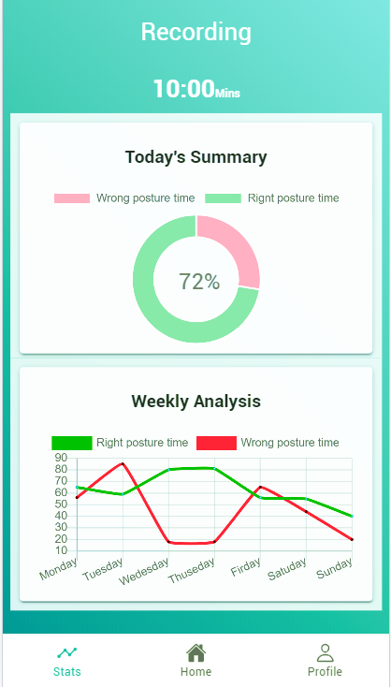
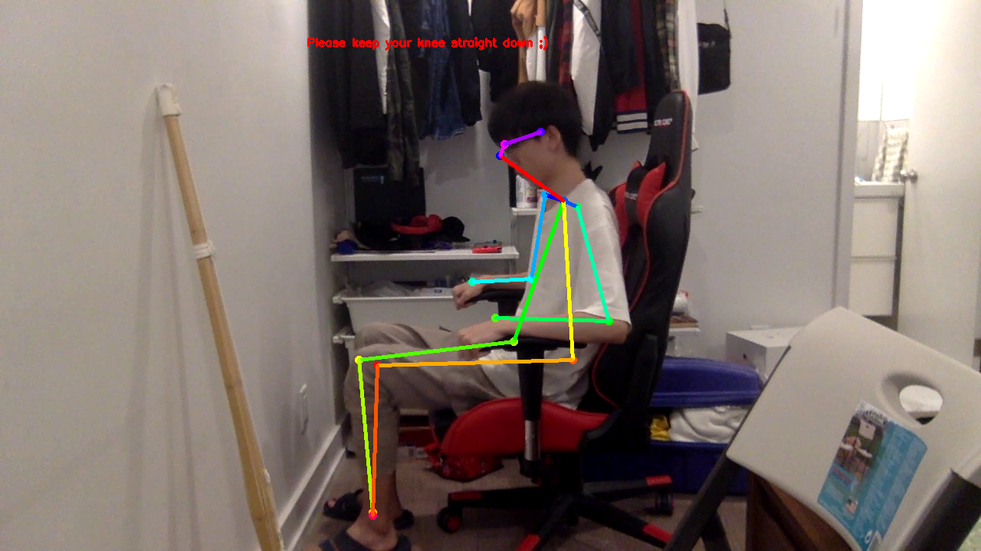
THE PROCESS OF USE
Sit-Up! – Frontend Interface
Cross-platform Frontend Tool: Ionic
Notes:
The device itself works perfectly without your phone or even internet.
But we still offer a free mobile platform to track your improvement throughout the process of use
As we will see later on in another demo, the screen here will display the instant feedback, and tells you what to do to correct your posture.
All those information will be logged, and auto-generated a posture tracking report.

Slide 9
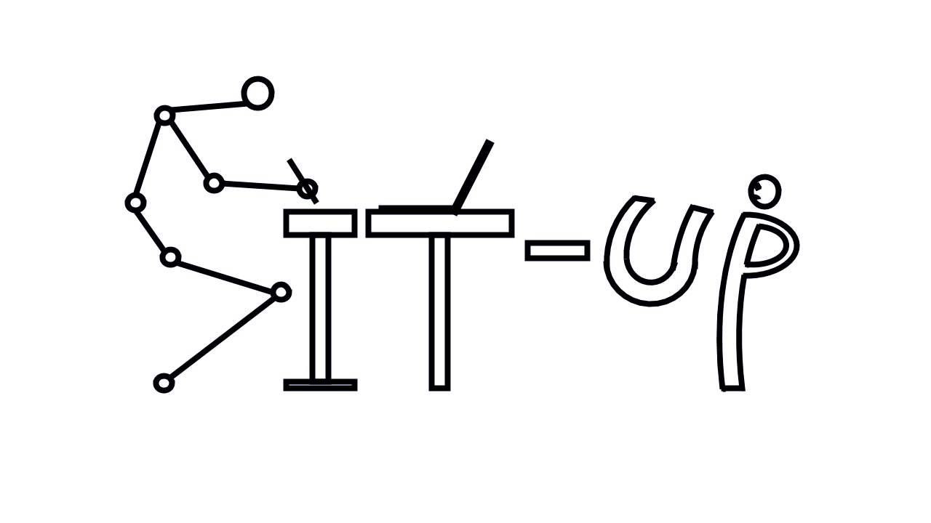
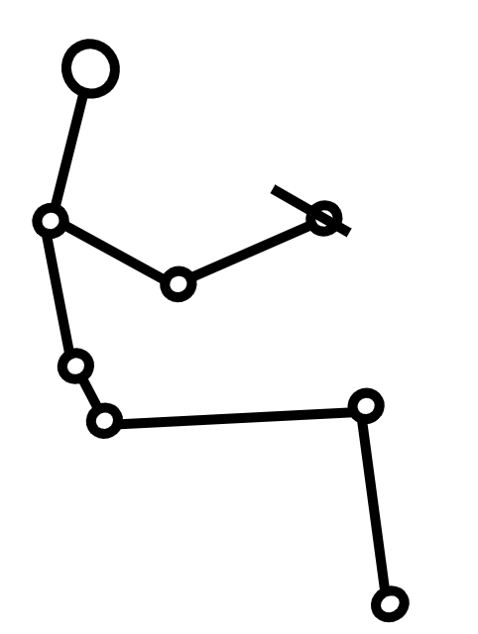
THE PROCESS OF USE
Sit-Up! – Backend Processing
Training:
Federated Learning
Input
Input
Camera
Model
Matching algorithm:
OpenPose
Input
Output
Correct model
Tolerance
Comment
Dataset: COCO dataset
Algorithm: OpenPose
Accuracy: 80+% for each individual joint
Notes:
For the backend process, after camera capture the image, it will be sent to the deep learning model, which will detect and pass your body feature to the Matching Algorithm:
Another input is a referencing body posture provided by several medical research report. After adding some tolerance to encounter some fluctuation. Then the matching algorithm will output the result and comment to help user to correct their posture.
Moreover, this feedback loop will put the output back to the model to train and improve the accuracy.
Wait a second, If you have heard about the surveillance crisis, listening to what I just said should raise a red flag to you. Having a camera facing me all the time? What about my privacy?

Slide 10
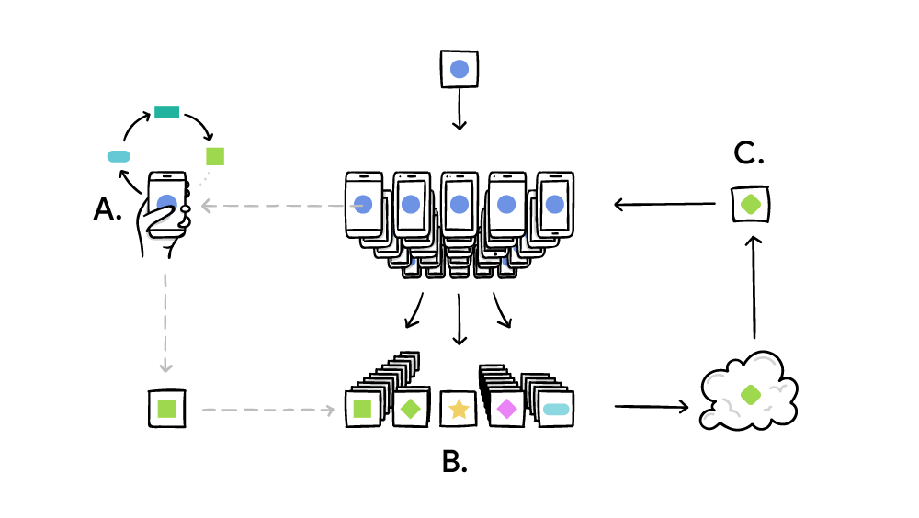
COUNTERING SURVEILLANCE CRISIS
Federated Learning ensures Security and Privacy
Algorithm:
Federated Stochastic Gradient Descent (FedSGD)
Notes:
Accurate and Secure comparing with other Federated Learning Algorithm, such as FedAvg & FedProx
That is an excellent question! And that is why all the users’ data would only be used through federated learning.
Federated learning is an idea raised by a Google research group in 2016. In shorts, it is an algorithm that improves a model’s accuracy without risking information leaking. And that is also why the device can work without connecting to phone or internet.

Slide 11



PRODUCT ADVANTAGE
Sit-Up! - The AI-powered device can achieve:
Simple
&
Flexible
Robust
&
Accurate
Cost-effective
Notes:
Flexible
Pocket size device that you can bring with you
The split structure allows you to change the charging adapter into table clamp. Via vision detection and the round screen design, it always provides the most suitable viewing angle, even if you put it upside down.
Accurate
The computer vision and the deep learning AI model can accurately locate your body postures. Instead of a single measurement, it finds your face, neck, shoulders, elbow, spine, etc., measures all angles between them, and gives you instant feedback.
Moreover, the model learns by itself! As people start using it, the data will activate the training process to make the model more and more accurate and personalized
Cost-effective
The second advantage is being cost effective.
There are many ergonomics devices in the market, and I did had a serious consideration of getting one to my workspace. However, their prices just scared me away. To be honest, their target users are never an average student, especially for people like me that need to work in both office and home.
At here, you no longer need to spend thousands of dollars to buy health. With only xxx dollars, Sit-up can help you to form a health sitting habit without building dependency on any external constraints.

Slide 12
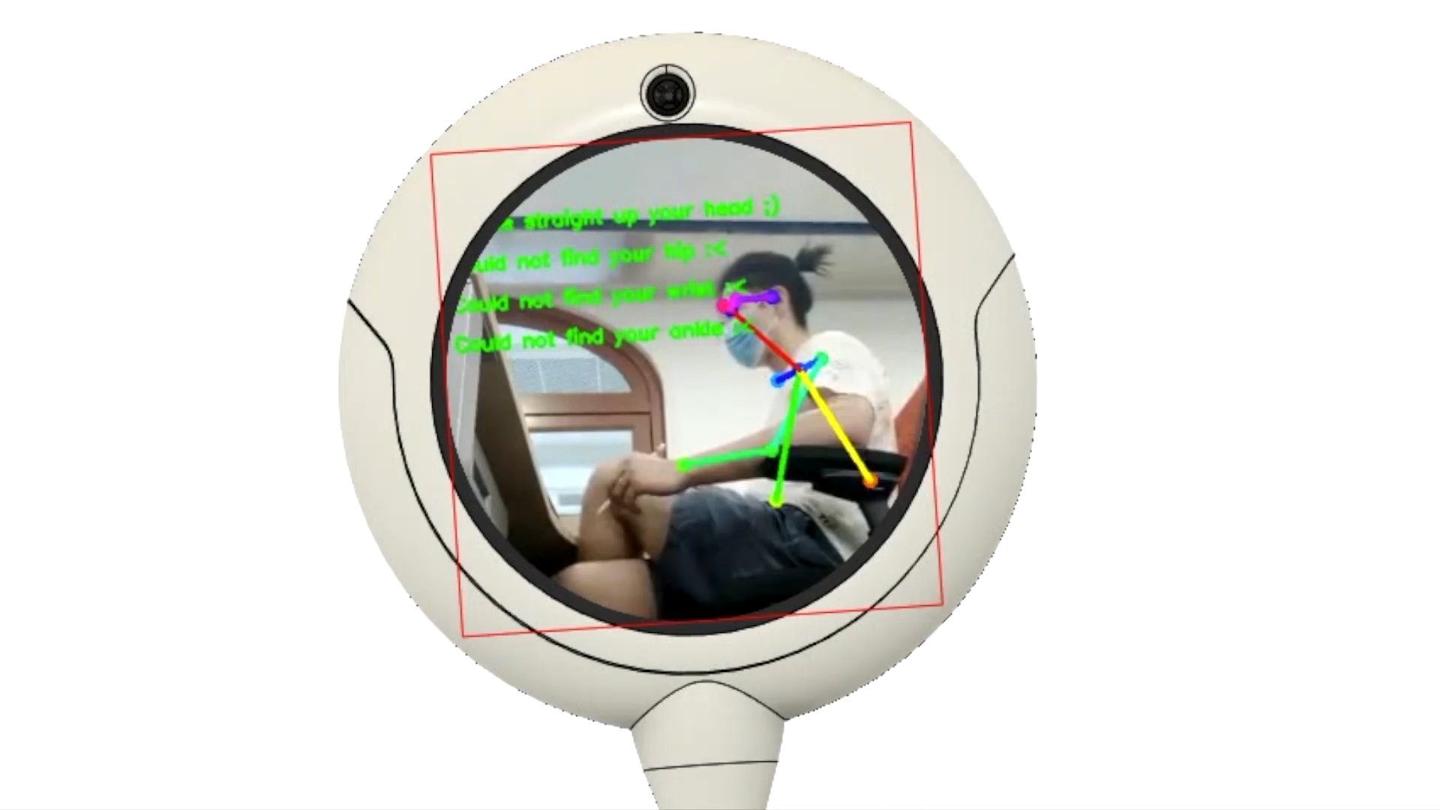
DEMO
Sit-Up! – Presenting

Slide 13

Q&A
Not Just Demo! Checkout our FULLY functional product at:
https://github.com/yAya-yns/Sit-up.git

Slide 14


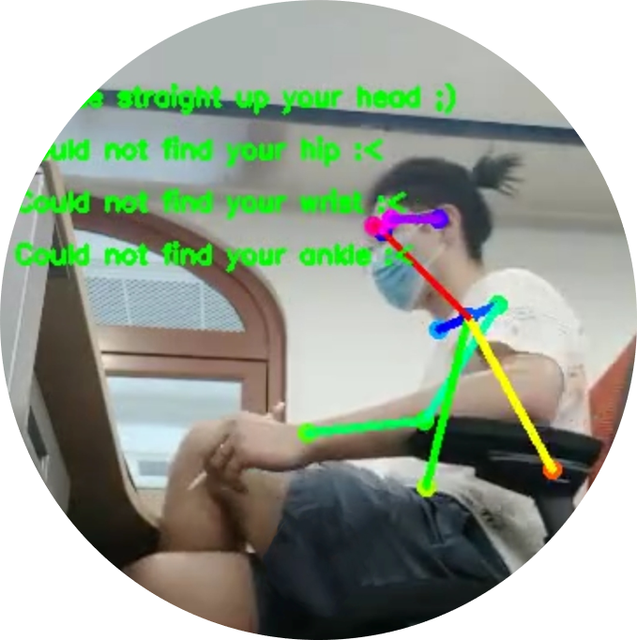
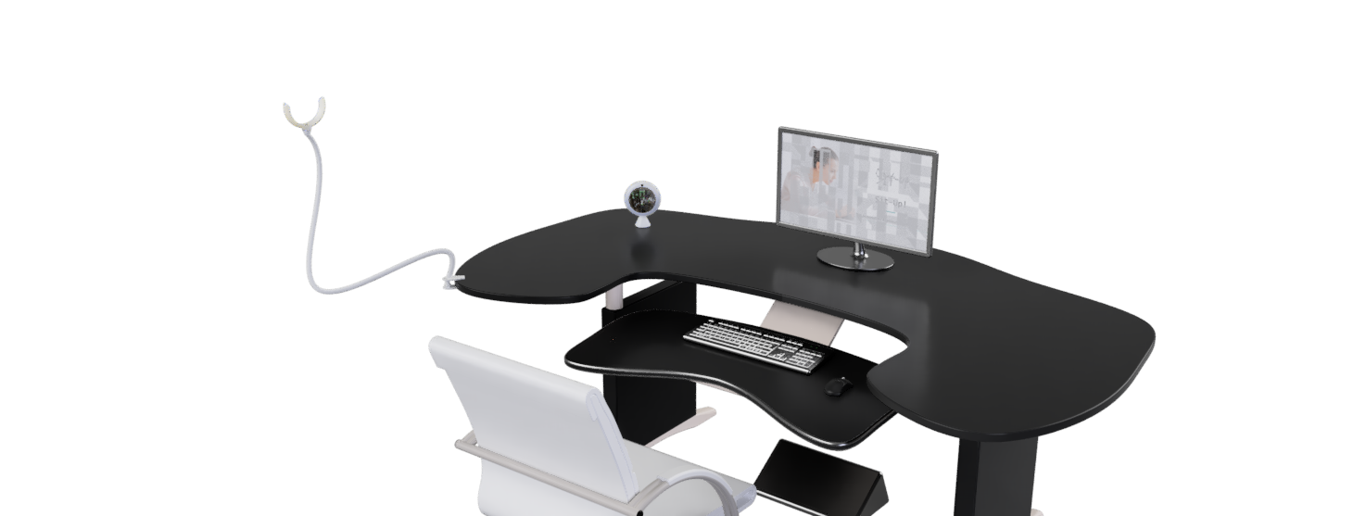
APPENDIX
Real Product
Flexible with Rotation, Round screen design and auto-calibration algorithm allows it to face up no matter how you orient it

Slide 15
APPENDIX
Error Posture

Slide 16
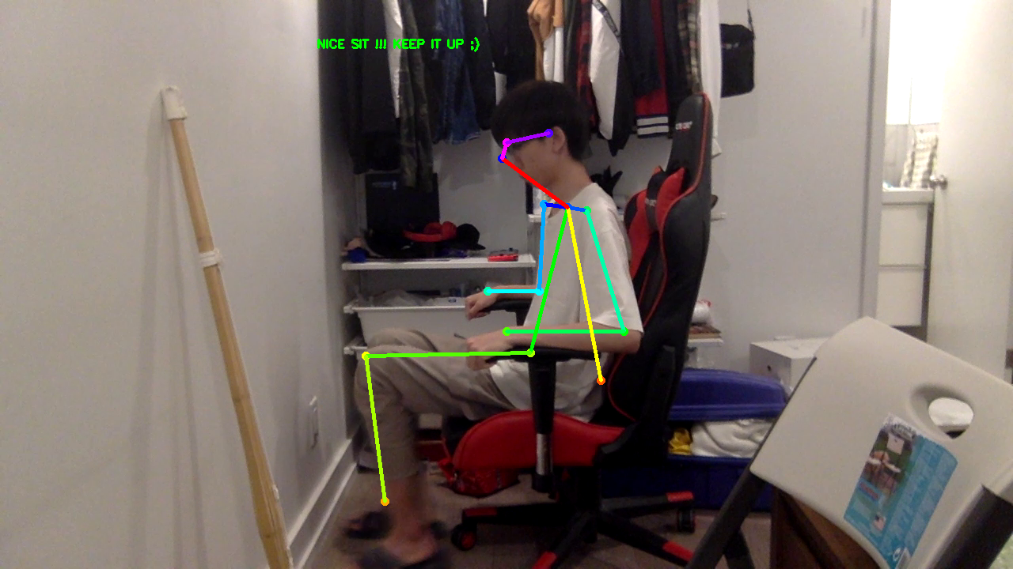
APPENDIX
Correct Posture

Slide 17
APPENDIX
Backend Process
Input
Input
Camera
Model
Matching algorithm:
OpenPose
Input
Output
Correct model
Tolerance
Comment
Dataset: COCOdataset
Algorithm: OpenPose
Accuracy: 80+%

Slide 18
APPENDIX
Demo app interface

Slide 19
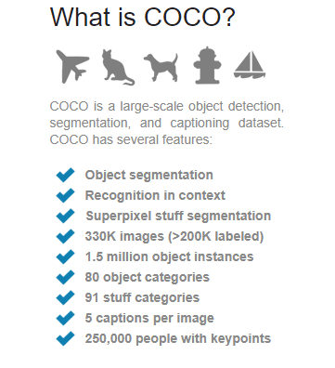
APPENDIX
Training Data

Slide 20
REFERENCE
Presentation
https://www.health24.com/Medical/Backache/Good-posture/Slouching-a-real-back-breaker-20120721
https://www.mensjournal.com/health-fitness/4-reasons-stop-slouching/
https://www.thegoodbody.com/back-pain-statistics/
https://www.acatoday.org/Patients/What-is-Chiropractic/Back-Pain-Facts-and-Statistics
https://www.therooststand.com/blogs/the-roost-blog/12381213-the-cost-of-poor-posture
https://www2.deloitte.com/us/en/insights/industry/technology/technology-media-and-telecom-predictions/2020/ai-chips.html
https://www.techinsights.com/blog/apple-iphone-5s-teardown
https://ai.googleblog.com/2017/04/federated-learning-collaborative.html
https://towardsdatascience.com/federated-learning-and-privacy-preserving-ai-fcddbeb426c5
Backend
https://cmu-perceptual-computing-lab.github.io/foot_keypoint_dataset/
https://arxiv.org/abs/1812.08008
https://github.com/CMU-Perceptual-Computing-Lab/openpose

